Slide 1
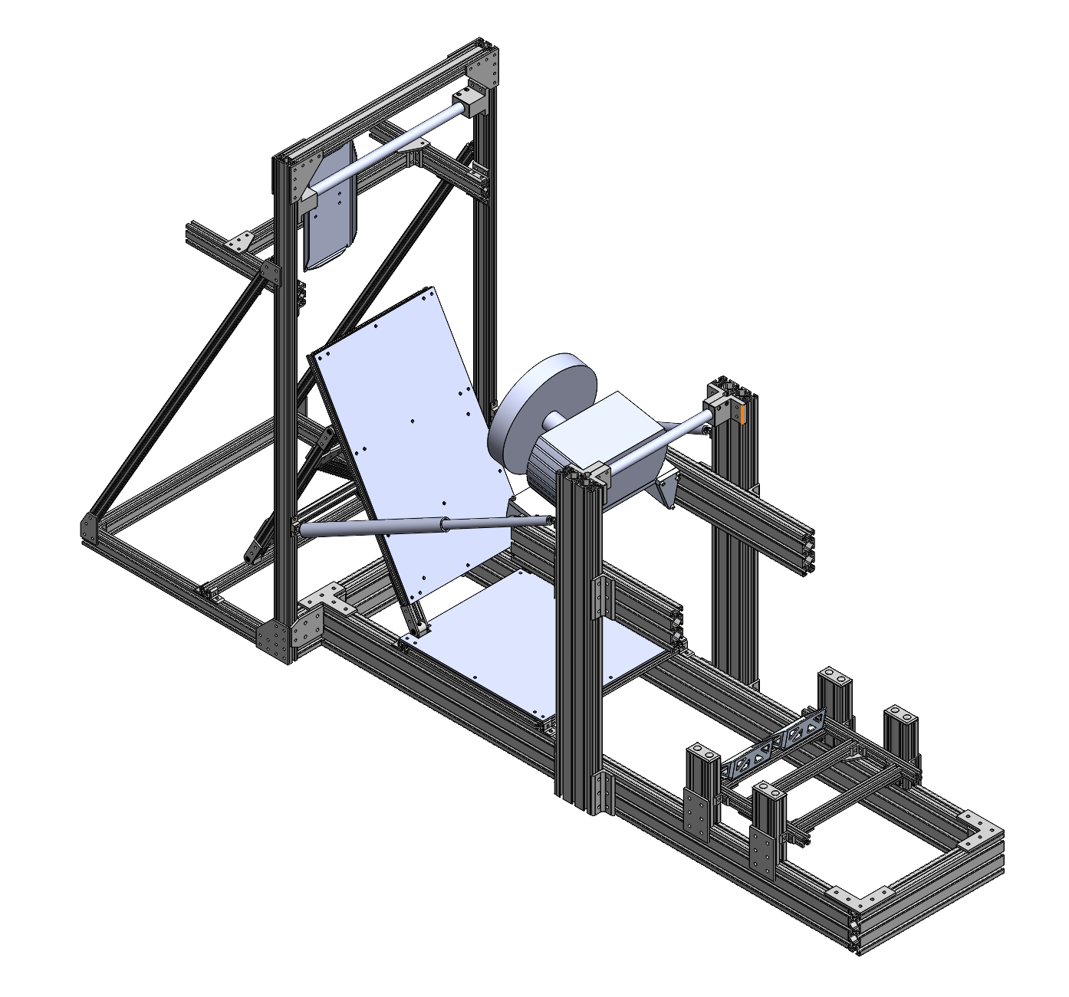
The Rig™ CDR
System Leads: Pravir Das, Tate Johnson, Bisrat Mekonnen, Gabriel Prado, Tony Tao
Manager: Jennifer Yang

Slide 2
DESIGN REVIEW ATTENDANCE
Jennifer Yang
Pravir Das
Gabriel Prado
Bisrat Mekonnen
Tate Johnson
Luis
Aidan Honnold
Griffin Della Grotte
Victoria Han
Andrew Fu
Spencer Haver
Gabriel Botero
Kailee Donez
Kalen Gressler
Danny Marks

Slide 3
AGENDA
Design Goals and Specifications
Rules Requirements
Design Overview
Costs Summary (BOM)
Schedule
Documentation

Slide 4
DESIGN GOALS
Original Goals
Create an adjustable rig
Receive feedback from drivers on how to comfortably position elements the driver interacts with
Reusable for many years
Additional Goal
Create a simulation rig for driver practice and testing
Notes:
We want to be able to find the most comfortable position for the drivers
In order to do this, we have the following goals in mind:
Adjustable rig
Driver feedback on comfort
Reusable

Slide 5
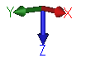
DESIGN SPECIFICATIONS
Headrest
Z position
X position
Seat
X position
Angle
Front roll hoop
X position
Z position
Main roll hoop
Z position
Steering wheel
Z position
X position
Angle about Y
Pedals
Z position
X position
Angle about Y
Face Z position (WRT Heel Support)
Face X position (WRT Heel support)
Notes:
Choose to adjust these elements based on goals
Most valuable for positioning
Origin at base of MRH - DRAW IT SOMEWHERE @JENNIFER
XYZ see little axis thing

Slide 6
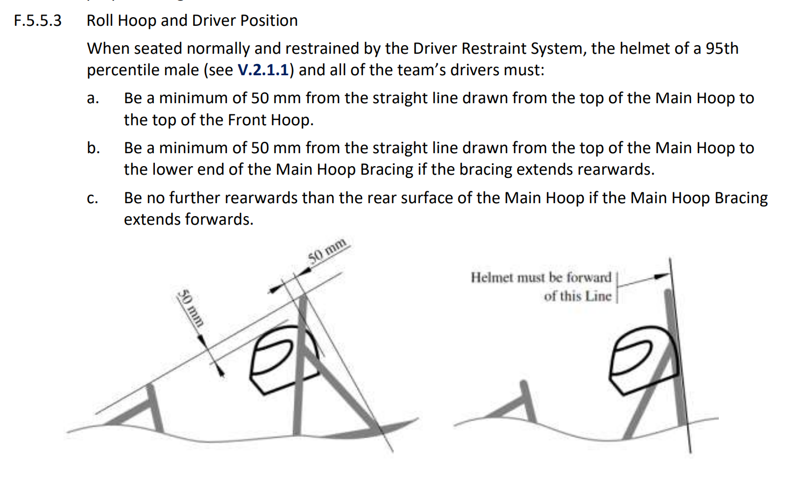
DESIGN CONSTRAINTS: RULES REQUIREMENTS
Link to rules spreadsheet here
Important Rule: F.5.5.3 – Roll Hoop and Driver Position
When seated normally and restrained by the Driver Restraint System, the helmet of a 95th percentile male (see V.2.1.1) and all of the team’s drivers must:
Be a minimum of 50 mm from the straight line drawn from the top of the Main Hoop to the top of the Front Hoop.
Be a minimum of 50 mm from the straight line drawn from the top of the Main Hoop to the lower end of the Main Hoop Bracing if the bracing extends rearwards.
Be no further rearwards than the rear surface of the Main Hoop if the Main Hoop Bracing extends forwards.
Notes:
Linked a spreadsheet of rules that constrain the movement allowance
Key rule is the F553
They do this at comp so we want to make sure it works before chassis design
Essentially is used to ensure that the driver is within the car and will be safe in the event of a rollover
Test is roughly performed by having a long straight object placed from FRH to MRH and checking to see that helmet to stick is at least 50 mm

Slide 7
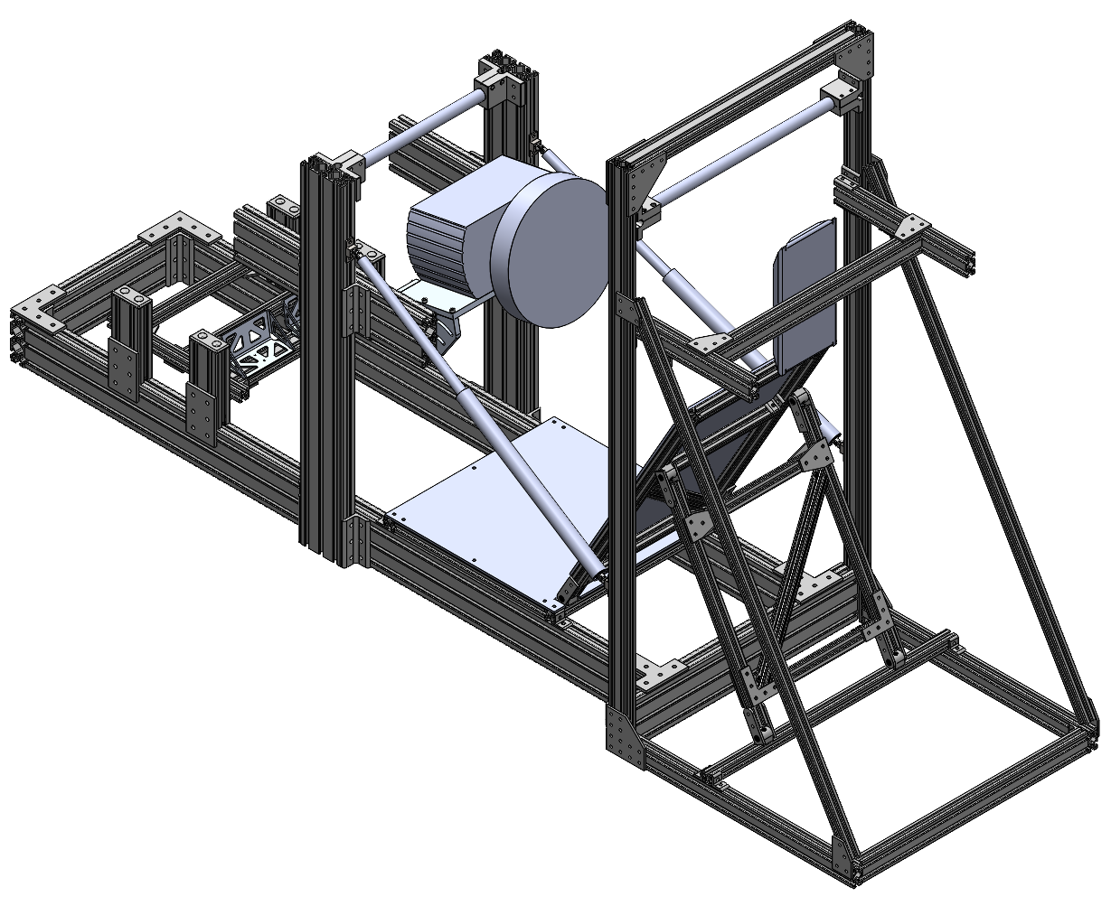
DESIGN OVERVIEW

Slide 8
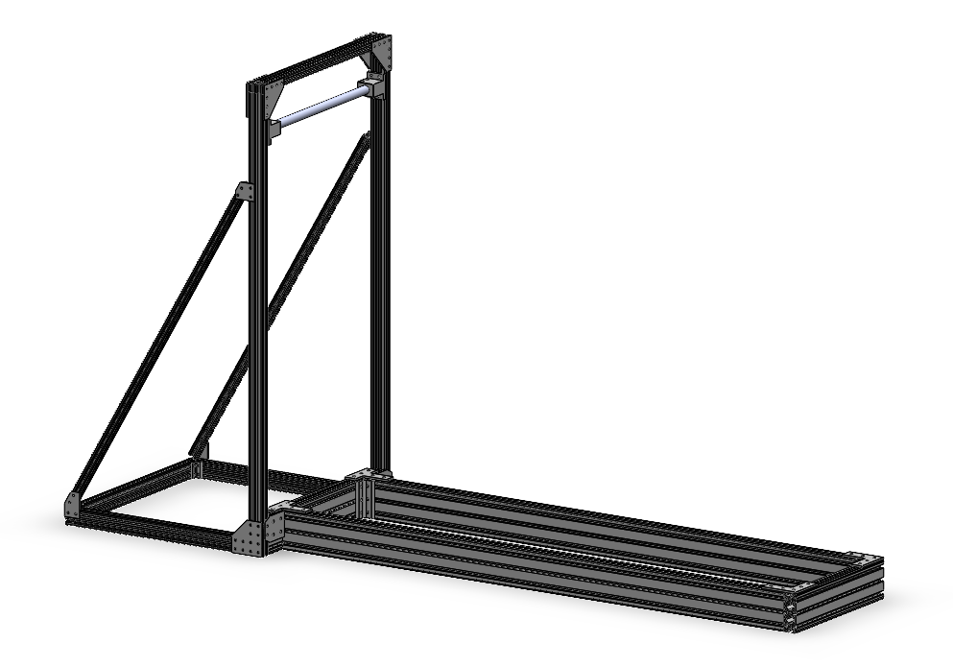
CHASSIS
Function
Main rigid structure
React steering torque efficiently
React various loads from driver
Fixed MRH for measurement origin
Notes:
Minimize vibrations? -> React Torque Effectively
Reiterate origin is center of the base of the MRH in this slide -> clarify origin and explain mrh z movement

Slide 9
CHASSIS
MRH Adjustable Vertically
Triangular Bracing for Headrest and Anti-flex
Fixed Main Roll Hoop
Bigger Extrusion for Wheel and Pedals Stiffness
Notes:
Rigid is a weird word
Slide ordering?

Slide 10
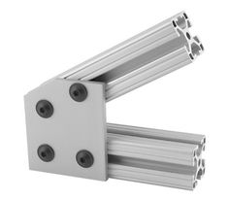
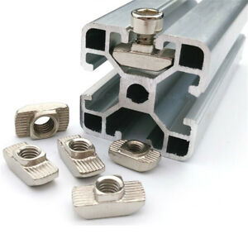
CHASSIS
Manufacture and Assembly
All 80/20 inc. aluminum extrusion and off-the-shelf parts
T -slot profiles
Extrusion lengths ordered pre-cut
Can begin assembly immediately after parts arrive
Notes:
Looking for process and timeline here
Could potentially be put after full rig design picture bc this info is kinda general to all systems

Slide 11
CHASSIS
Name of Part | Mfg Method(s) | Location(s) | Lead time
MRH Brackets | 3D printed clamp | Andrew’s house | 3 days
MRH PVC pipe | Band saw | ICE | 1 day

Slide 12
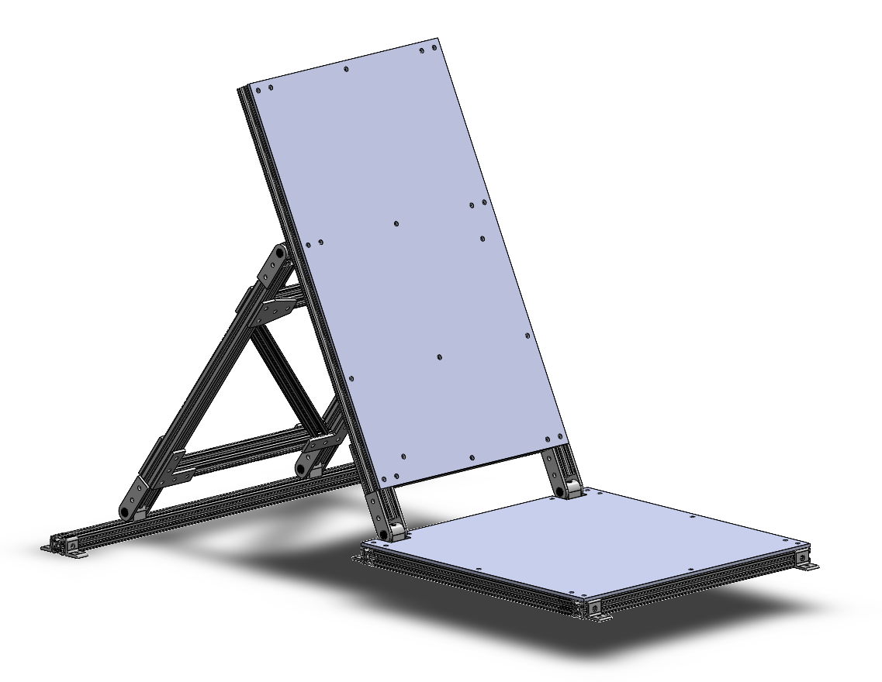
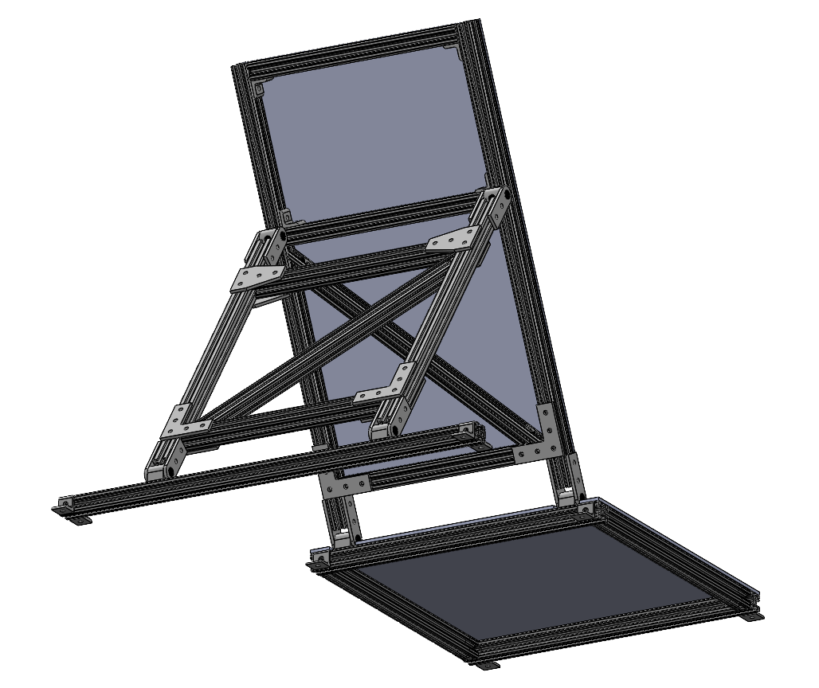
SEAT
Function
Support driver forces
Assume all real car positions
Recline and provide X-dir adjustability
Notes:
Recline vs adjust seat back angle

Slide 13
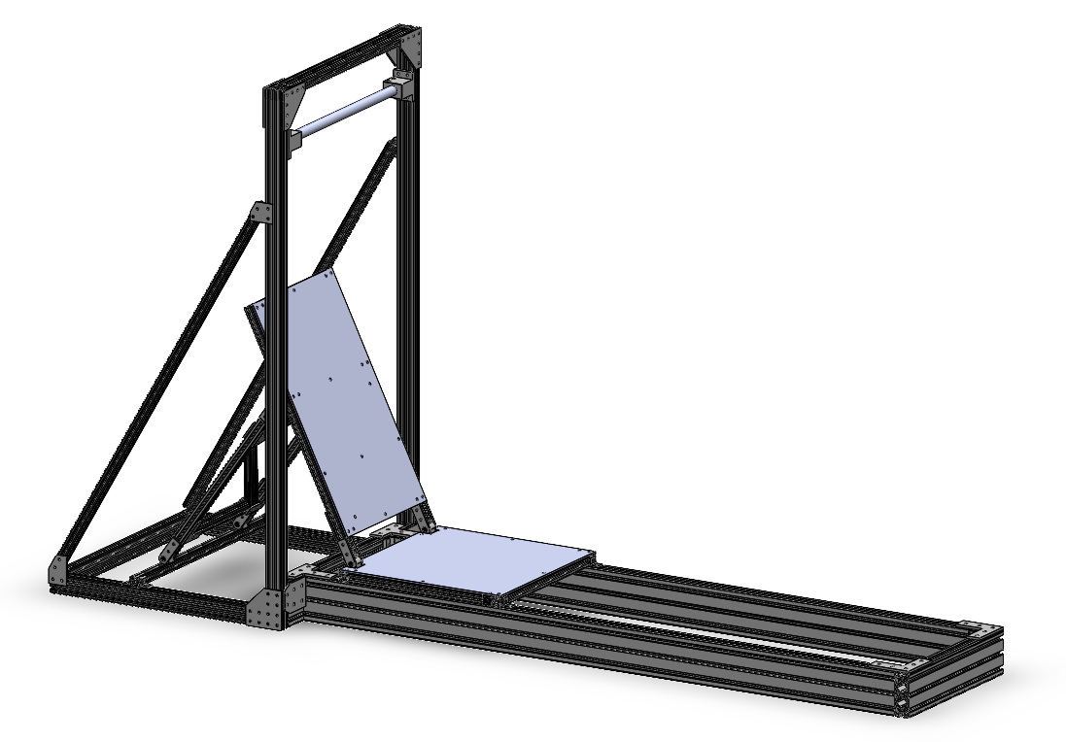
SEAT
Actual seat ideas:
Cushions attached to plates
Separate seat molded into chassis frame
Potentially split along lower back
Potential addition of harness
Can use leftover harness (from 17e)
Notes:
We want to bring this up at the end of the cdr - discussion topic

Slide 14
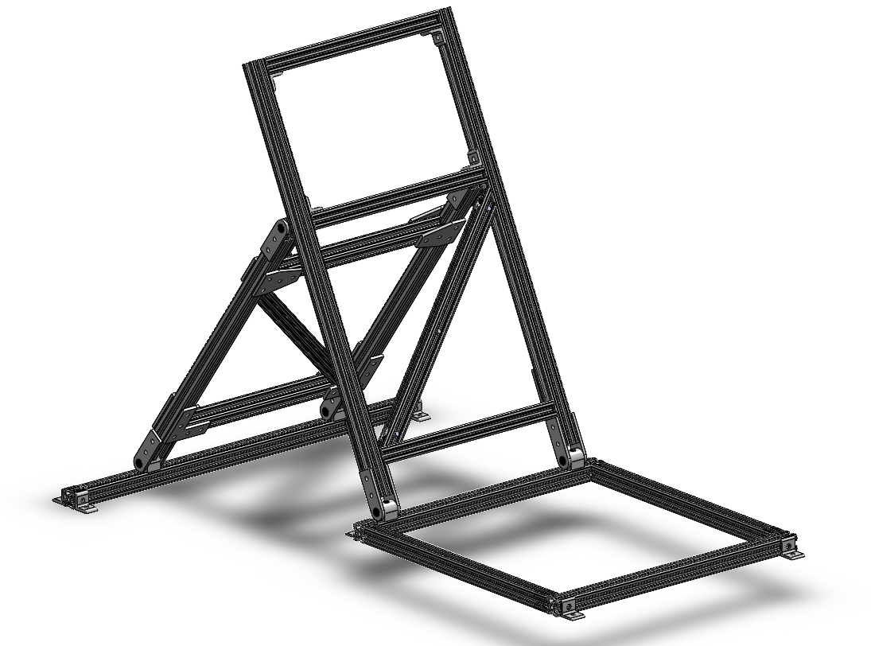
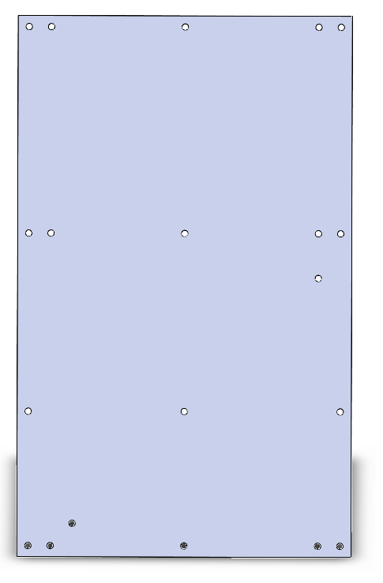

SEAT
Assembly
Mostly off-the-shelf 80/20 inc components
2 custom laser cut plywood plates
Begin cutting and assembly ASAP

Slide 15
SEAT
Name of Part | Mfg Method(s) | Location(s) | Lead time
Seat Backing Pieces | Laser Cutter | TechSpark | 1 day

Slide 16
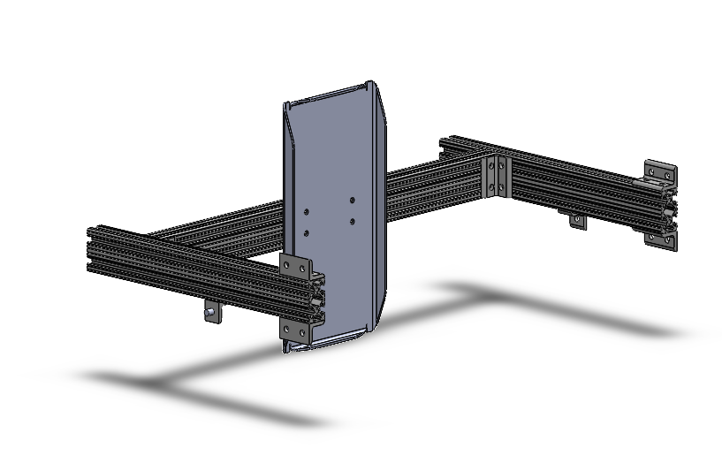
HEADREST
Function
Support driver head
Reference position from MRH
Adjustability in z and x dir

Slide 17
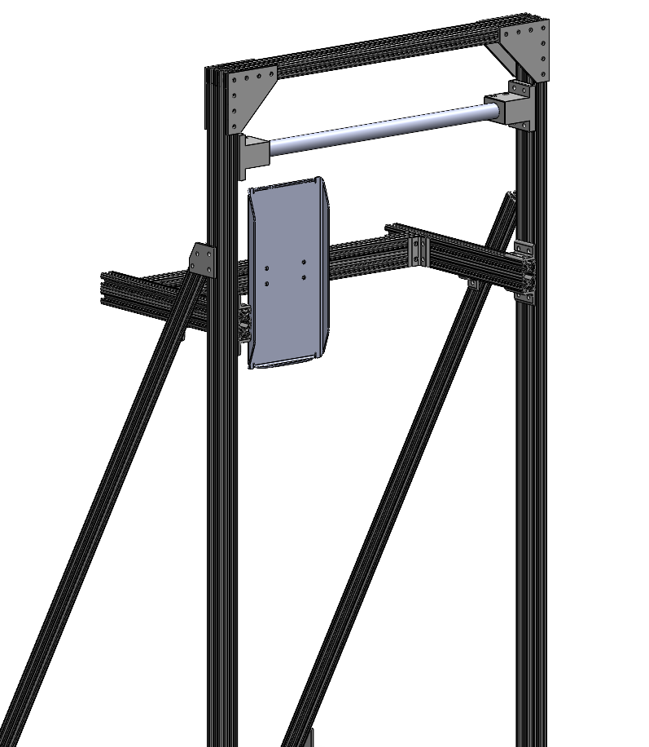
HEADREST
Assembly
Mostly off-the-shelf 80/20 inc components
Custom machined head rest plate
Begin machining and assembly ASAP
Notes:
Waterjet cut and bent and drill out holes

Slide 18
HEADREST
Name of Part | Mfg Method(s) | Location(s) | Lead time
Headrest Backing Plate | WaterJet | Outsource | 2 weeks

Slide 19
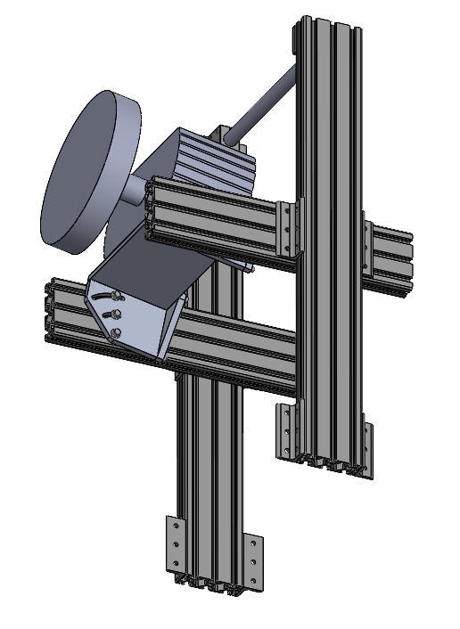
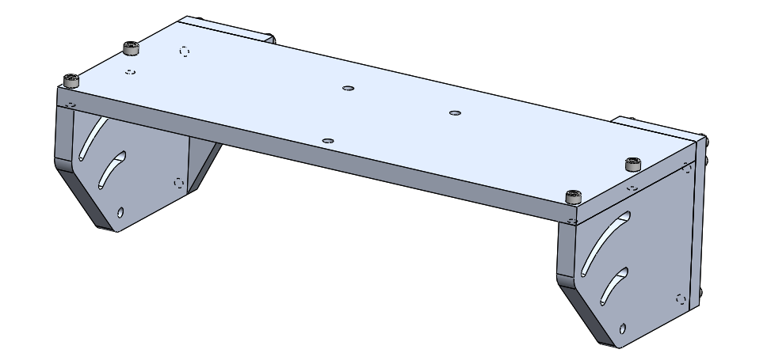
STEERING WHEEL
25 cm forward from FRH adjustability in the X
Z adjustment limited to the height of FRH 8020 bars
45 degree angled slot for the angle about Y
Will be able to use purchased steering wheel and CMR wheel through spline adapter
Notes:
Steering wheel vs steering simulation base?
Think bigger scope - it’s everything of the subassembly not just steering wheel and frh vertical pieces
Not a rigid -> should probably be adjustable instead
Picture is easier to explain
List capabilities
Probably delete red highlight
Ways it can move (both SW and FRH)
Steering wheel choice tbd - have option to use bought steering wheel but also can do spline adaptation?

Slide 20
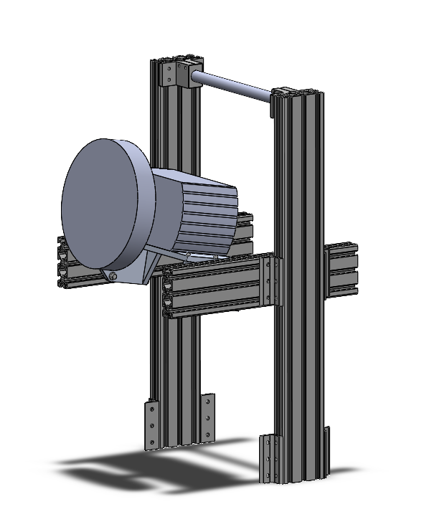
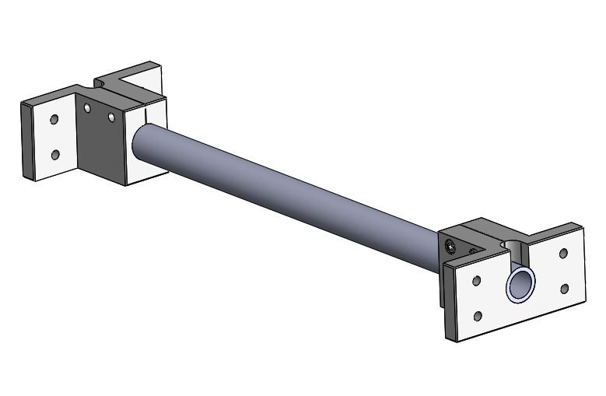
FRONT ROLL HOOP
Moves in the X direction
Top bar moves up and down in Z
Notes:
Steering wheel vs steering simulation base?
Think bigger scope - it’s everything of the subassembly not just steering wheel and frh vertical pieces
Not a rigid -> should probably be adjustable instead
Picture is easier to explain
List capabilities
Probably delete red highlight
Ways it can move (both SW and FRH)
Steering wheel choice tbd - have option to use bought steering wheel but also can do spline adaptation?

Slide 21
STEERING WHEEL AND FRONT ROLL HOOP
Manufacturing
Name of Part | Mfg Method(s) | Location(s) | Lead time
Top Plate | Mill | TechSpark | 1 day
Side Plates | Mill and CNC | TechSpark | 1 day
Back Brackets | Mill | TechSpark | 1 day
Tube Mount | 3D Printer | TechSpark | 2 day
Tube | BandSaw | TechSpark | 1 day
Notes:
Make the manufacturing process a table? (part, machine, time in days)
Assembly after manufacturing
Assembly is a generic order of operations

Slide 22
STEERING WHEEL AND FRONT ROLL HOOP
Assembly
Assemble steering top, side and back plates
Assemble Front Roll Hoop Mounts onto Front Roll Hoop Tube
Use brackets to mount z adjust bars to the rig chassis base
Mount FRH sub-assembly to z adjust bars
Mount x adjust bars to z adjust bars
Mount steering sub-assembly to x adjust bars
Notes:
Make the manufacturing process a table? (part, machine, time in days)
Assembly after manufacturing
Assembly is a generic order of operations

Slide 23
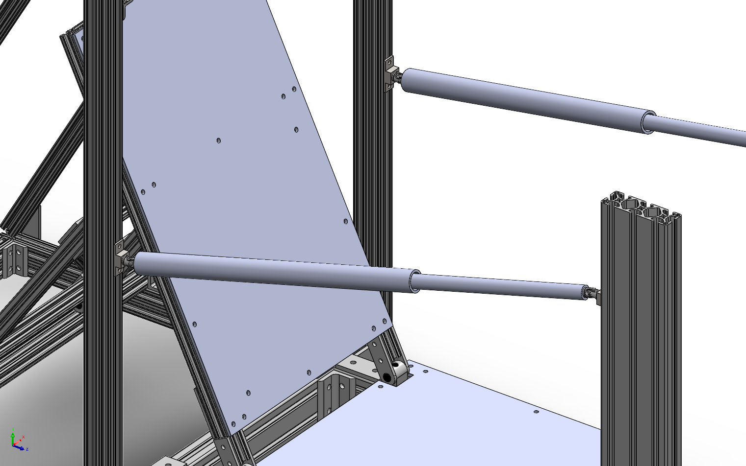
SIDE IMPACT MEMBER
Provides spatial reference for the location of the side impact members relative to the driver
Allows for more complete ergonomic analysis
Made with PVC, U-joints, and aluminum mounting brackets
Notes:
Bring up at end of cdr - do we still want the y movement? (not angle - thinking about end positions)

Slide 24
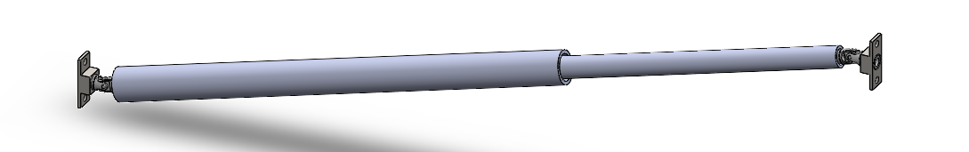
SIDE IMPACT MEMBER
Designed for independent height adjustment on hoop bars for all possible positioning in future cockpit designs
U-joints and telescoping PVC tubing allow for different side impact sizing and heights
Custom brackets lock to rails to fixed position using 8020 hardware

Slide 25
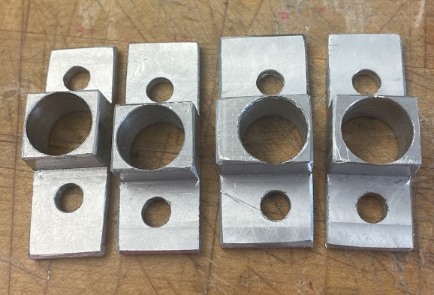
SIDE IMPACT MEMBER
Manufacturing
Name of Part | Mfg Method(s) | Location(s) | Lead time
U-joint brackets | Mill | TechSpark | Completed
PVC segments | Cutting | ICE | 1 day
Assembly
U-joints glued to PVC segments, joints then glued to brackets.
Bracket attachment to frame can be done at any time depending on timelines

Slide 26
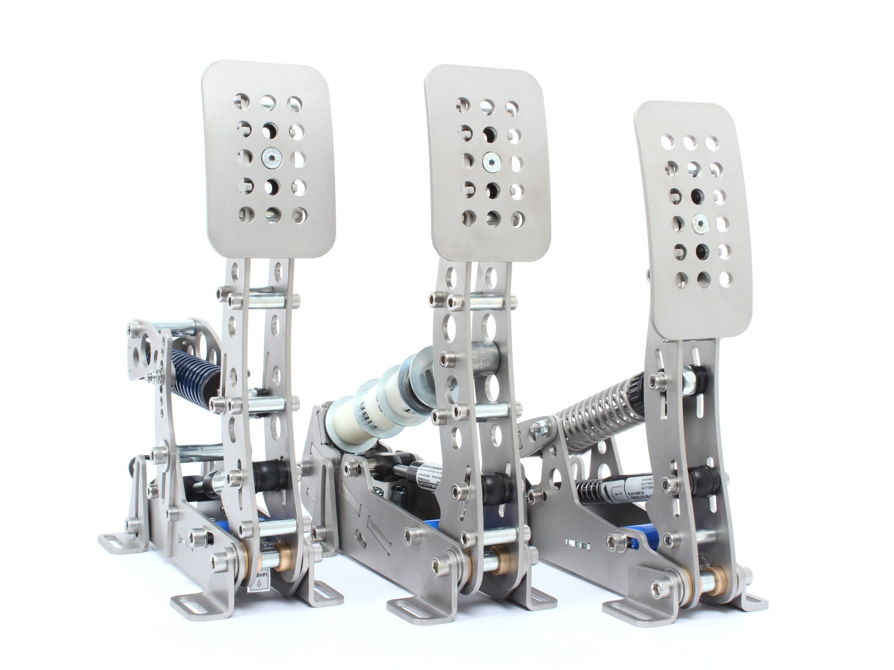
PEDALS
Heusinkveld Sim Pedals Ultimate
2 pedal set (brake + accelerator)
Extremely good adjustability

Slide 27
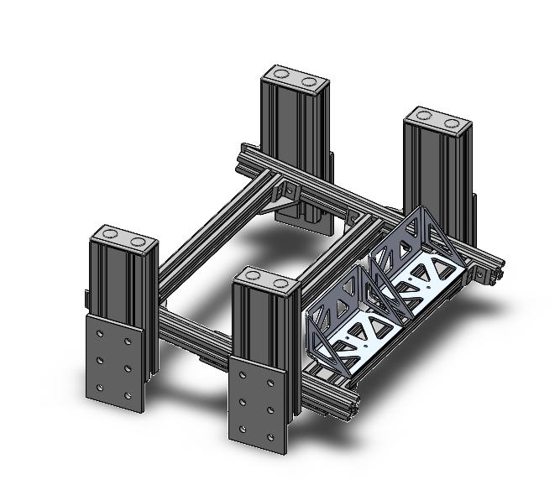
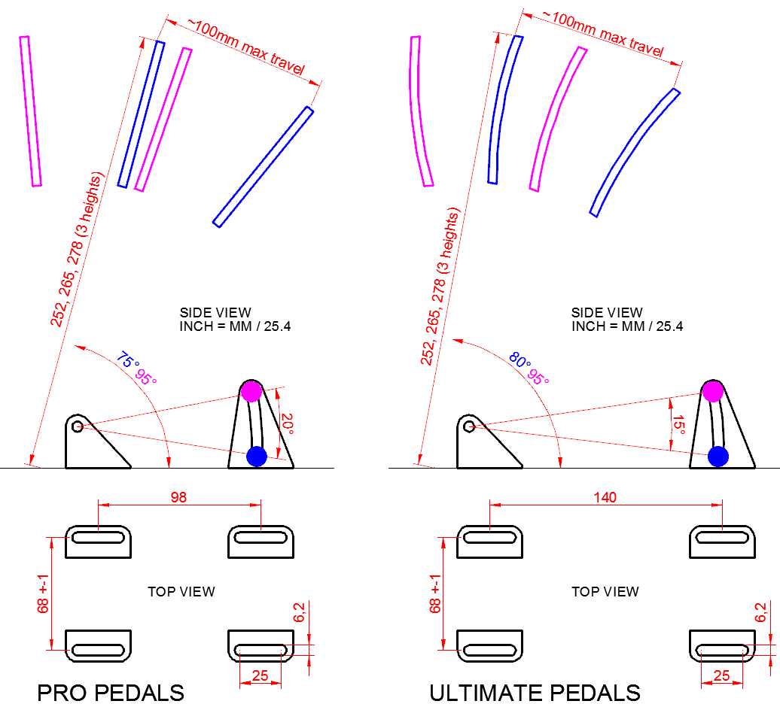
PEDALS
Heusinkveld pedals will fit current subframe

Slide 28
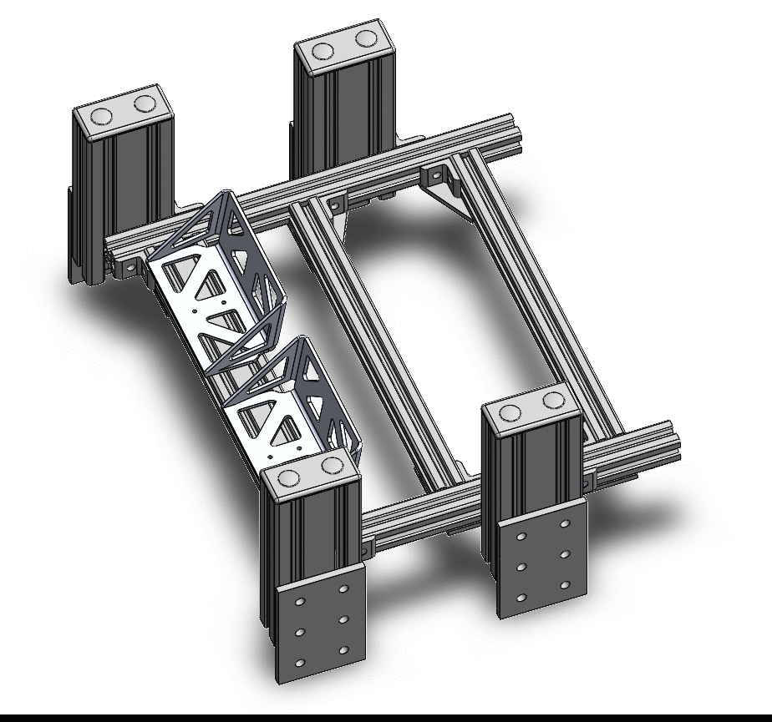
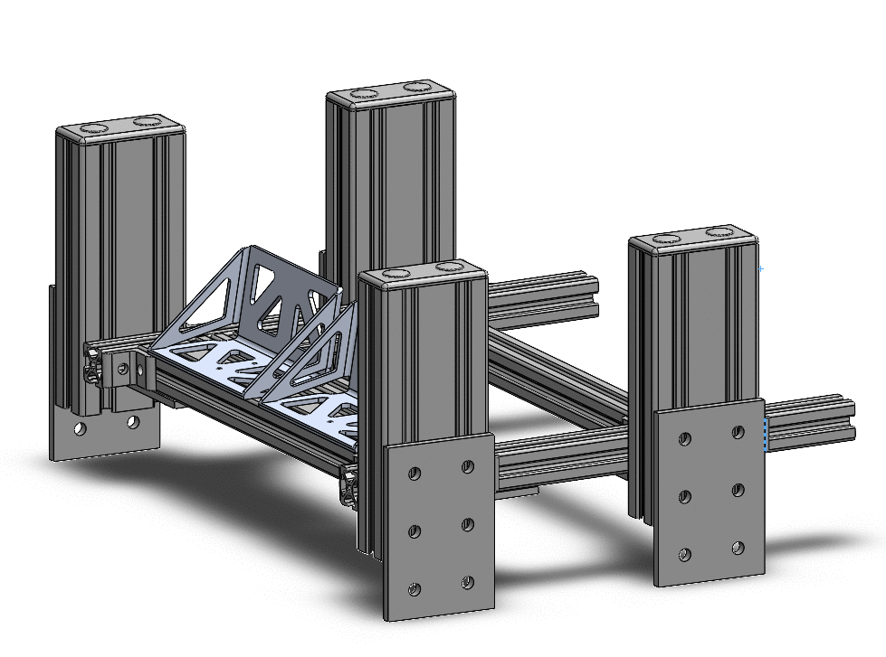
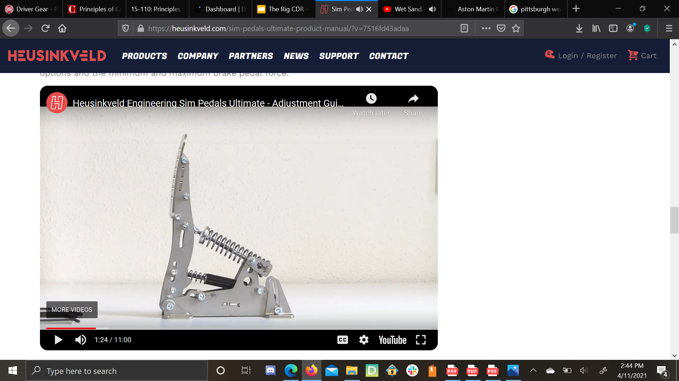
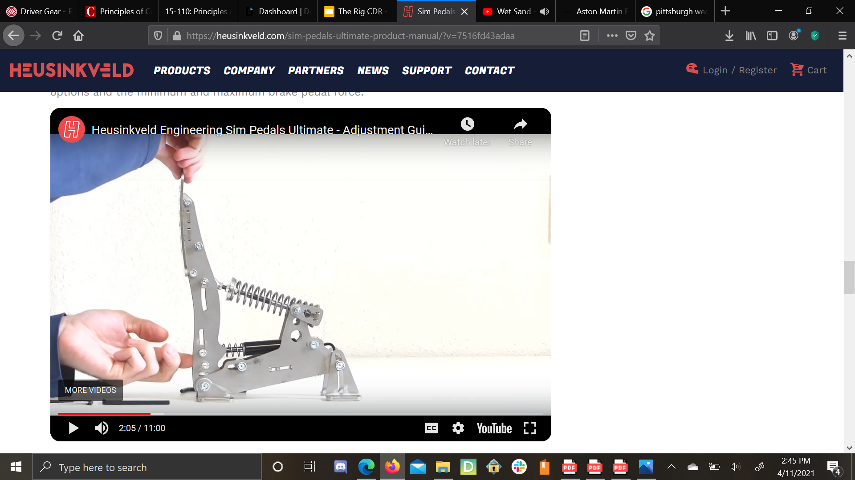
PEDALS
Serves as an adjustable structure for mounting pedals and heel cups
Pedal face can be adjusted relative to the heel cups in X and Z
Heel cups can move in X and Z
Angle of pedals can be adjusted about Y
Angle of pedal face can be adjusted independent of heel cup (thanks to Heusinkveld pedals)
Notes:
Moving pedal face relative to heel stop (in x and z)
Moving pedals in x direction as a unit
Moving pedals in z direction as a unit
Moving pedal angle about y as a unit
What are we doing and be able to show visually where that corresponds to

Slide 29
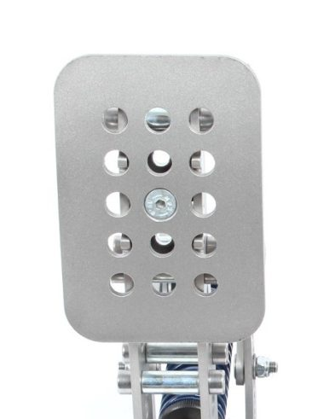
PEDALS
Adjustability
Pedal face adjustment system is very simple
Involves removing the center screw, moving pedal face to desired location, and placing screw in again.
We can easily machine our own pedal face to use

Slide 30
PEDALS
Name of Part | Mfg Method(s) | Location(s) | Lead time
Heel Cup | Waterjet | External Vendor | 2 weeks
All other parts will be purchased from 80/20 Inc and McMaster-Carr

Slide 31
PEDALS
Preload t-slot nuts into 80/20 H-frame
Assemble H-frame
Mount H-frame assembly to vertical 80/20s
Mount subframe to The Rig
Mount Heusinkveld pedals to subframe
Mount heel cups to subframe

Slide 32
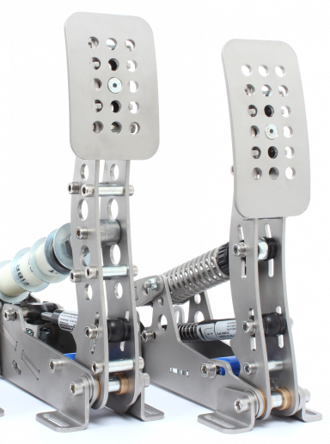
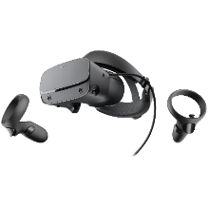
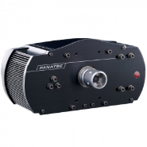
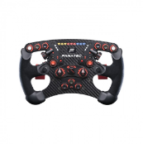
SIMULATION HARDWARE
Fanatec ClubSport wheelbase + Formula style wheel
Heusinkveld Ultimate Pedals 2 piece
Oculus Rift S

Slide 33
SIMULATION HARDWARE
Wheelbase
“Best of the rest” - belt driven
Up to 8 Nm of torque
Interchangeable wheels

Slide 34
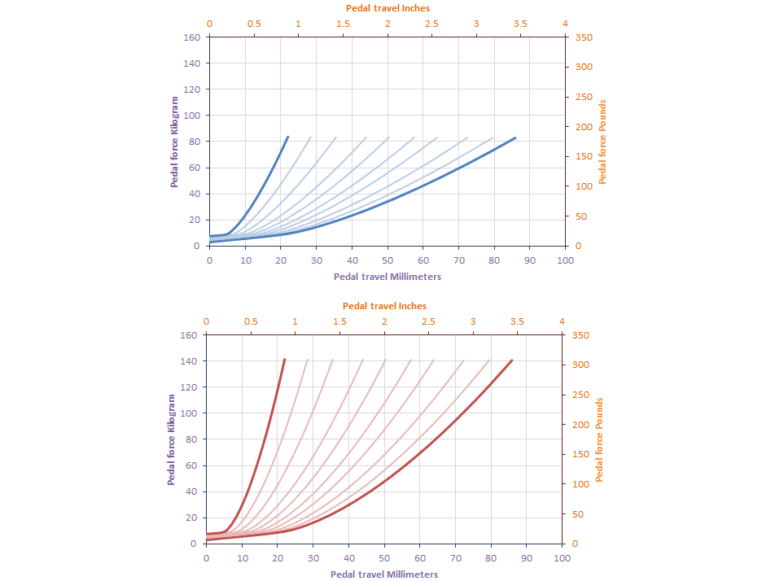
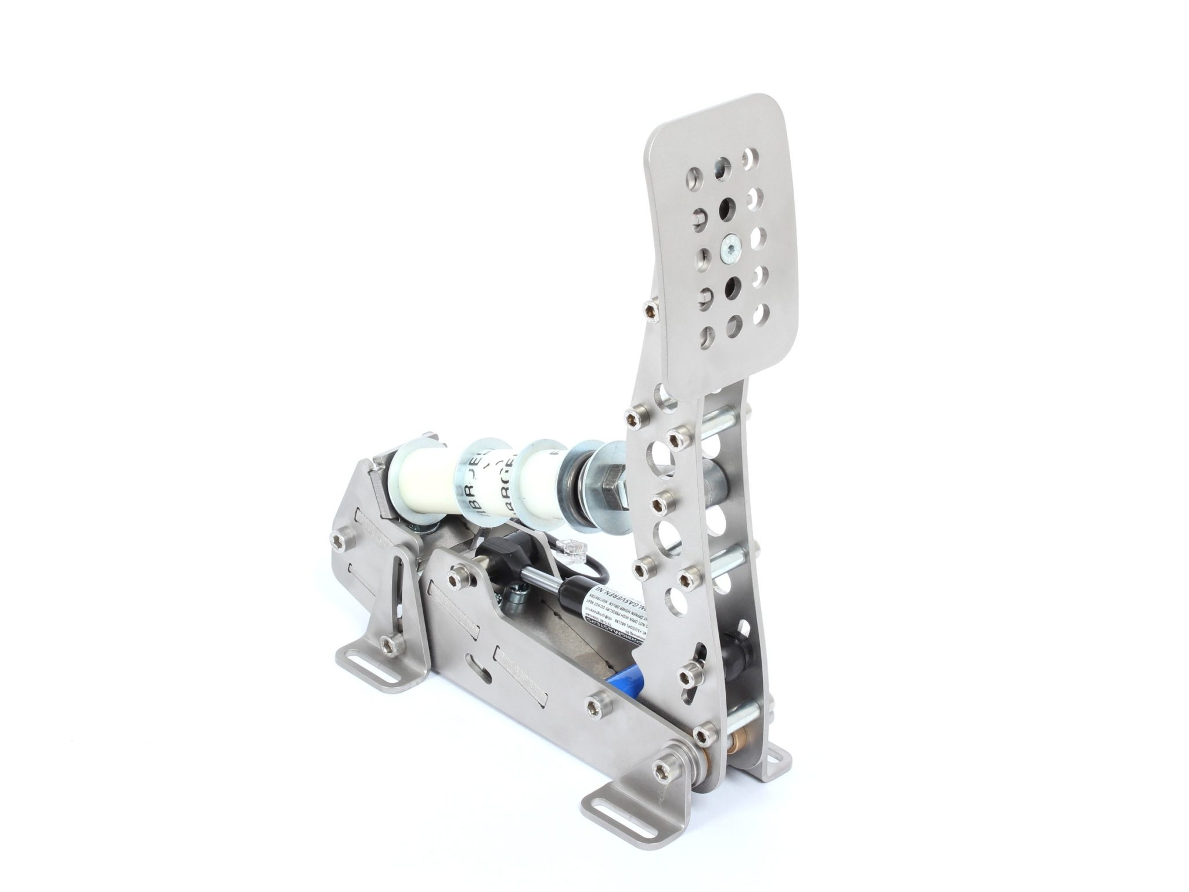
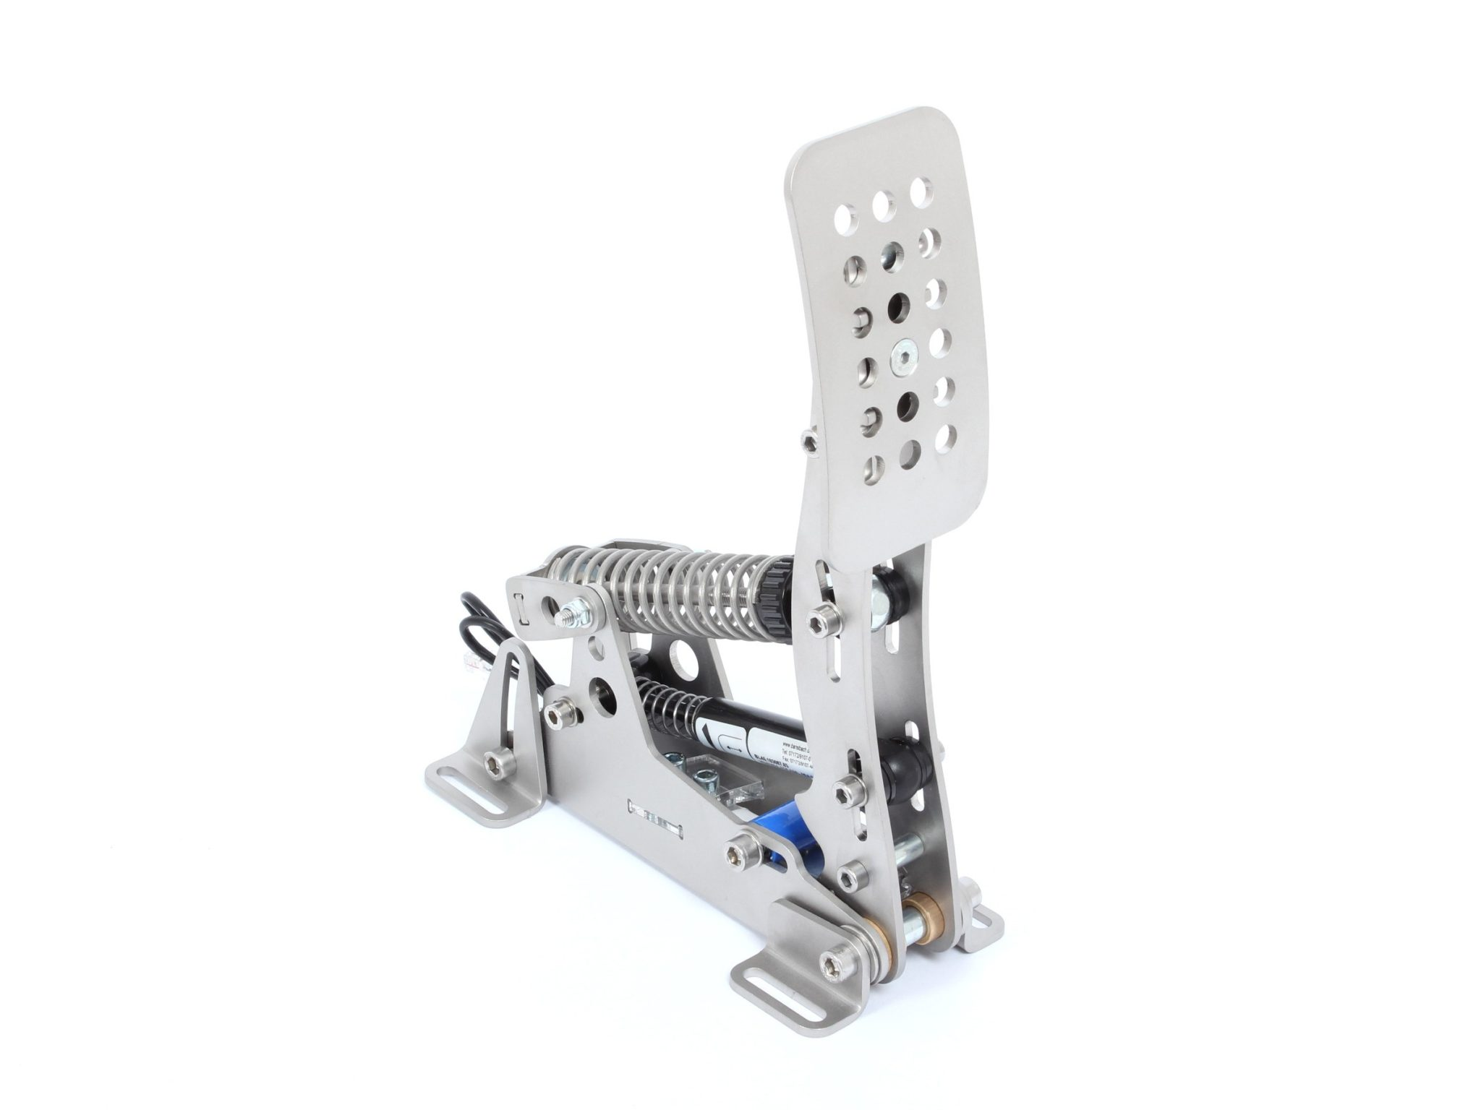
SIMULATION HARDWARE
Pedals
Literally could not ask for better pedals
Integrated hydraulic circuit
Tunable mass damper system
Max brake force of 300lbs

Slide 35
SIMULATION HARDWARE
Other Necessary Systems
VR headset TBD, no super obvious choice ~$400
PC specs TBD, as possible dual use as aero sim ~$700
Miscellaneous cords, connectors ~$200
Combined budget:
Steering wheel and base: $950
Pedals: Sponsored -> may need to pay shipping?

Slide 36
COST SUMMARY (BOM)
Assembly | Cost
Chassis | $1,592
Seat (casted seat) | $500
Steering Wheel | $105.41
Side Impact Member | $89.86
Pedals | $241.34
Simulation Hardware | Approx $2250
Total | Approx $4800
Original budget | $7000

Slide 37
SCHEDULE
Deliverable | Date
BOM Ordered | 4/17
Manufacturing Started | 4/17
Manufacturing Finished | 4/30
Assembly Started | When parts arrive
MVP Assembly Finished (ergo components) | 5/2
Full Assembly Complete | 5/7

Slide 38
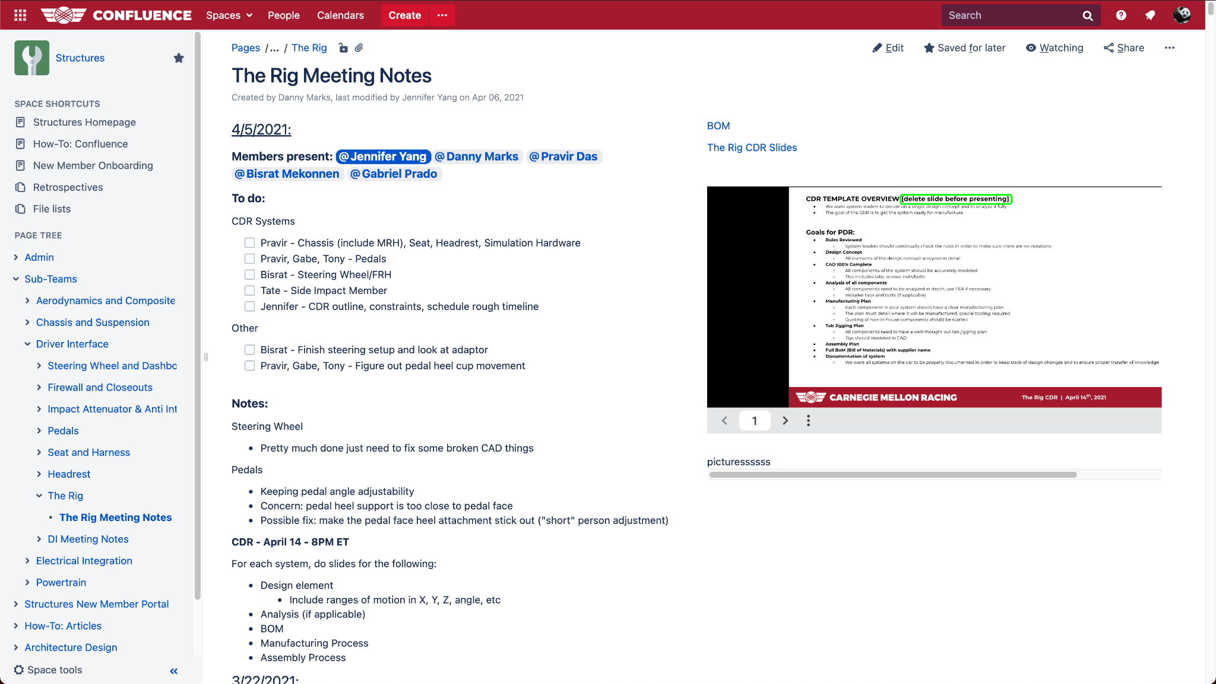
DOCUMENTATION
Structures → Sub-Teams → Driver Interface → The Rig → The Rig Meeting Notes

Slide 40
NOTES AND CONCERNS
Seat attachment/ type
Temporarily some sort of cushion
Spend more on steering wheel?
YEAH LETS FUCKING DO IT
Side Impact Member Y Position
Something we want. Add horizontal sliders
Spare heel stops and headrest in ICE?
Use for now since they exist in ice
Take a closer look at each range of motion and make sure we have enough range
Origin is an imaginary point due to bent MRH (this is ok but good to note)
Wait until PC part prices go down til fall before buying

